Slide 1
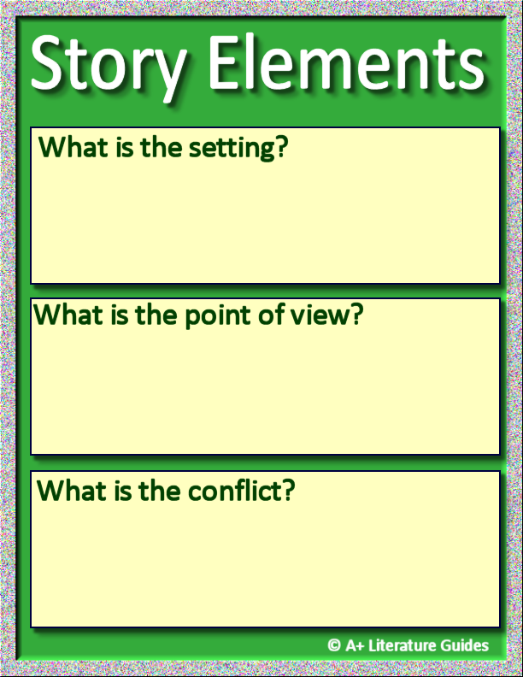
Insert text.
Insert text.
Insert text.

Slide 2
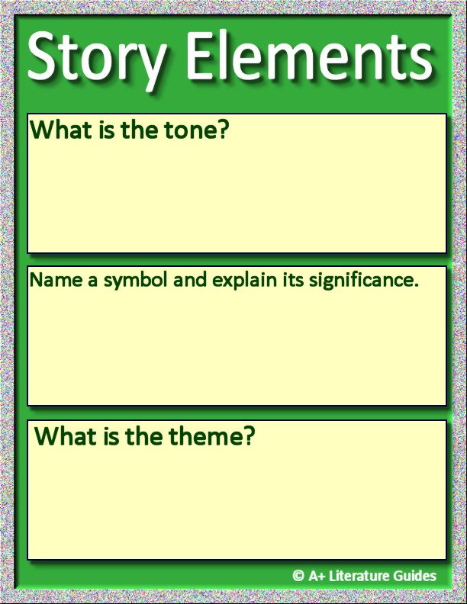
Insert text.
Insert text.
Insert text.

Slide 3
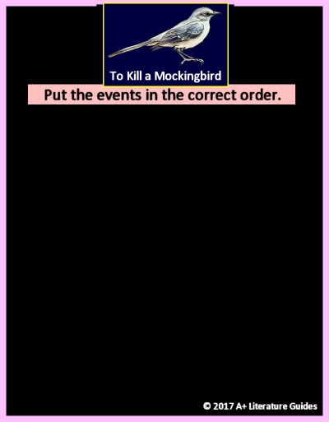






Drag and drop each event to place them in the correct order.

Slide 4
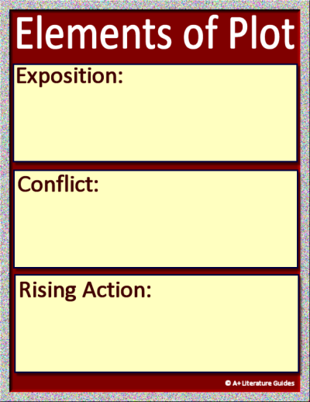
Plot Diagram: Novel
Insert text.
Insert text.
Insert text.

Slide 5
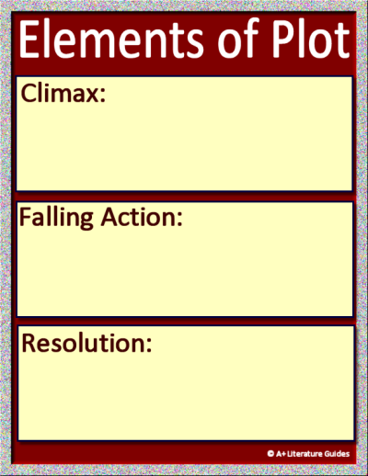
Plot Diagram: Novel
Insert text.
Insert text.
Insert text.

Slide 6
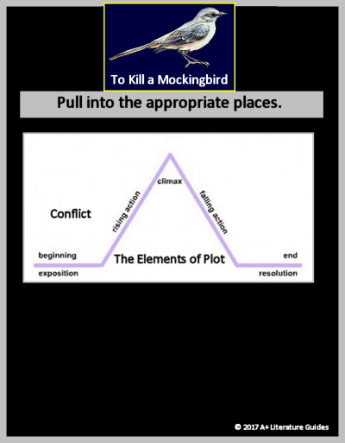






Plot Diagram: Scout
Drag and drop each event to the correct place on the plot diagram.

